Slide 1

Credit Card Usage Segmentation
A credit card company wants to group its customers based on their spending, payments, and credit usage. This helps them understand which customers spend more, who needs payment reminders, and who might need rewards. By using this app, you can explore these groups and find useful insights to help customers better!

Slide 2

The Problem
Why Do We Need to Segment Credit Card Customers?
Not all customers use their credit cards the same way.
Businesses face challenges in understanding behaviors such as:
Who spends more?
Who avoids large debts?
Who relies on credit for daily or big purchases?
Without segmentation, creating customized marketing strategies and personalized offers is difficult.

Slide 3

The Goal
What Are We Trying to Solve?
Group customers into segments based on behavior.
Use these segments for:
Customized marketing strategies.
Improving customer relationships.
Reducing Defaults and Managing Risk.
Maximizing Profits.
Callout: "Different groups, different needs!"

Slide 4
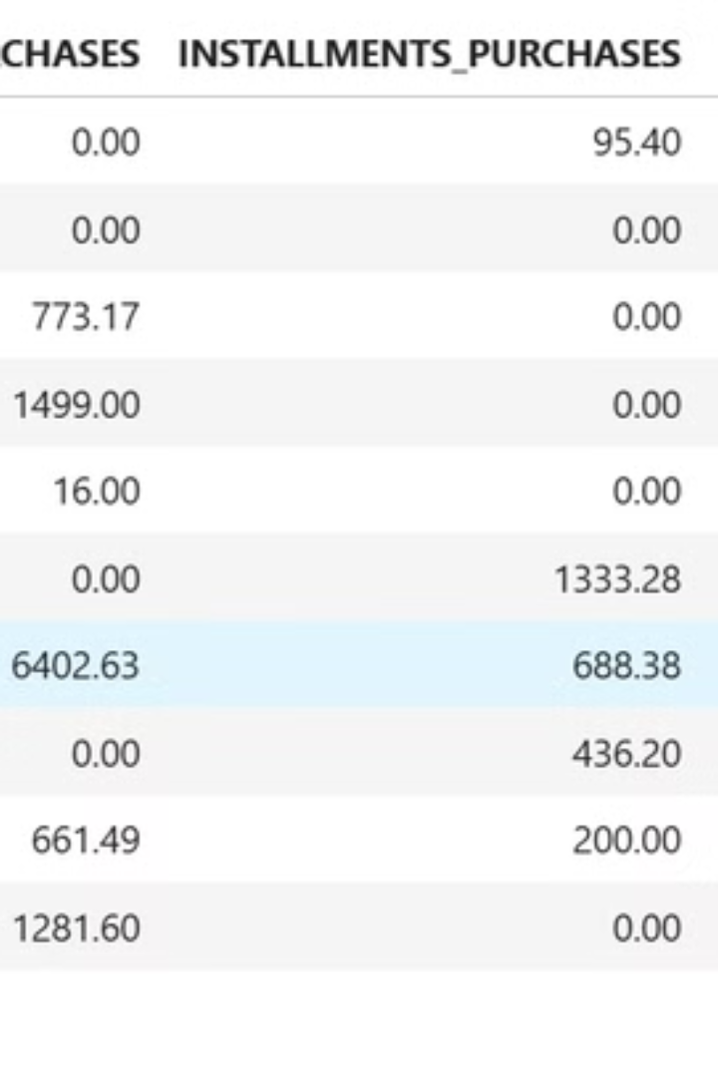



Meet the Data
Feature Engineering
Dataset Size
Key Features
Added helpful columns like Credit Utilization Ratio, Payment Ratio, and Monthly Average Purchases and Payments.
18 features, 8950+ customers.
Balance, Purchases, Credit Limit, Frequency of Transactions, Cash Advances, Duration, and Payments.

Slide 5

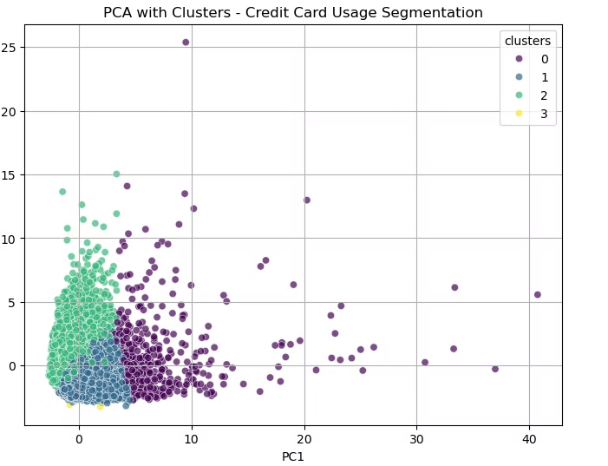
What is Clustering?
Heading: Understanding Clustering in Simple Words
Content:
Clustering = Grouping similar customers together.
Machines analyze patterns in behavior and divide customers into segments.
Example: Sorting a crowd by T-shirt color!
K-Means Clustering:
Groups people into ‘K’ clusters.
We chose K=4

Slide 6
Preparing Data for Clustering
Data Collection
1
Gather the necessary data from various sources.
2
Data Preprocessing
Clean, handle missing values, and standardize the data.
Feature Engineering
3
Extract and select the most relevant features for the analysis.
4
Model Selection
Choose the appropriate unsupervised learning algorithm, such as K-means, Hierarchical Clustering, or PCA.
Model Training
5
Train the selected model on the preprocessed data.
6
Model Evaluation
Assess the model's performance using metrics like Silhouette score and Elbow method.
Model Tuning
7
Optimize the model's parameters to improve its accuracy.
8
Deployment
Integrate the trained model into a production environment.
Monitoring and Maintenance
9
Continuously monitor the model's performance and maintain it for optimal results.

Slide 7
Overview of Credit Card User Segments
Credit Utilization
Spending Behavior
Payment Behavior
Business Focus
Big Spenders
High – Luxuries, large purchases.
Moderate to High (50-80%).
Pays most but may carry debt.
Offer premium rewards & travel perks.
Everyday Essentials Users
Low – Groceries, bills.
Very Low (<20%).
Always pays in full.
Promote cashback on essentials.
Credit-Reliant Borrowers
Limited – Emergencies, cash advances.
Very High (near or at limit).
Minimum payments, high debt.
Educate on debt management, offer plans.
Minimal Users
Very Low – Rare usage.
Extremely Low (<10%).
Pays in full when used.
Encourage usage with small rewards.

Slide 8
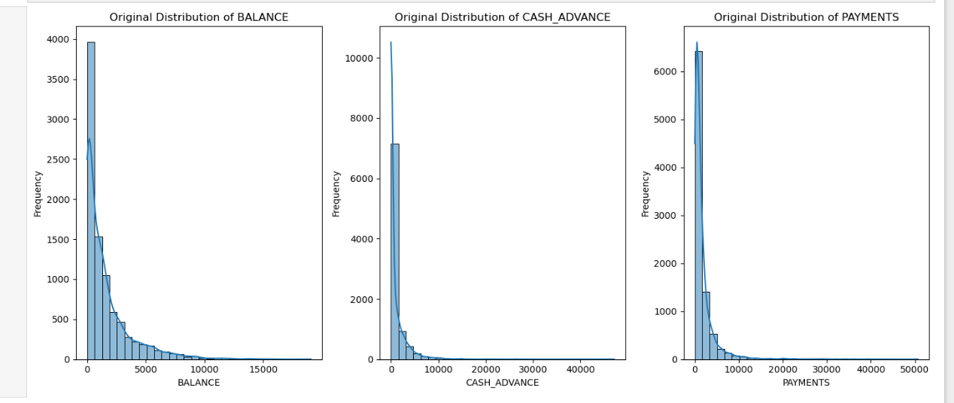
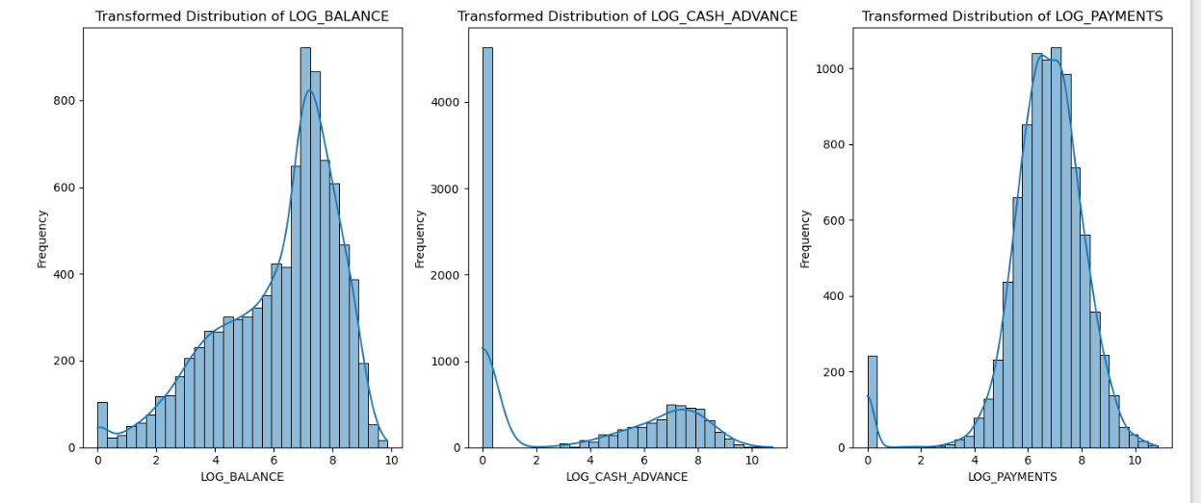
Visualization

Slide 9
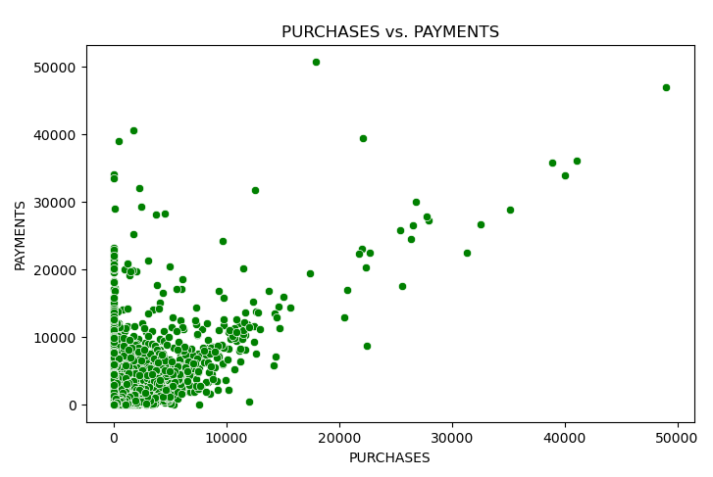
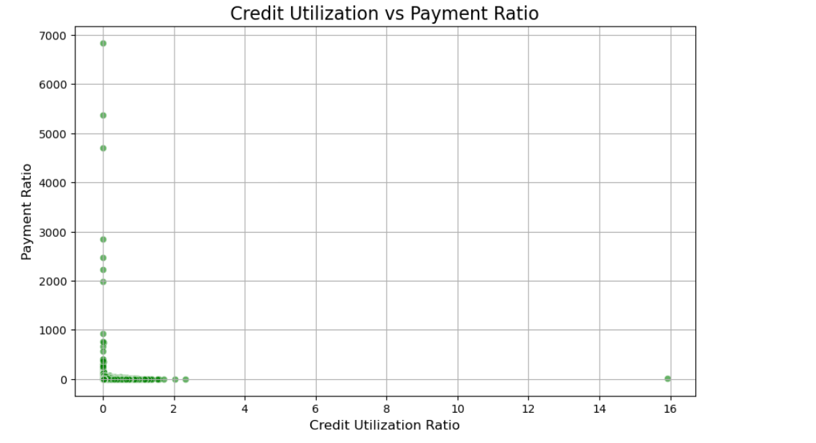
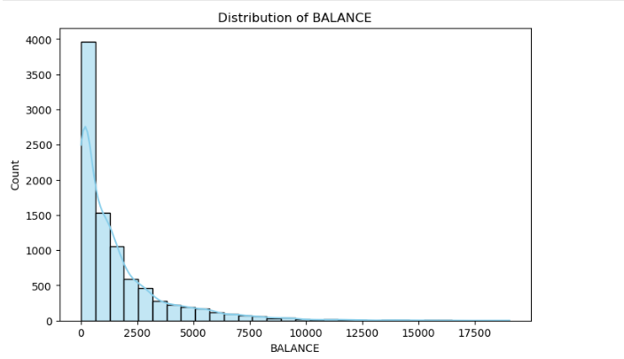

Slide 10
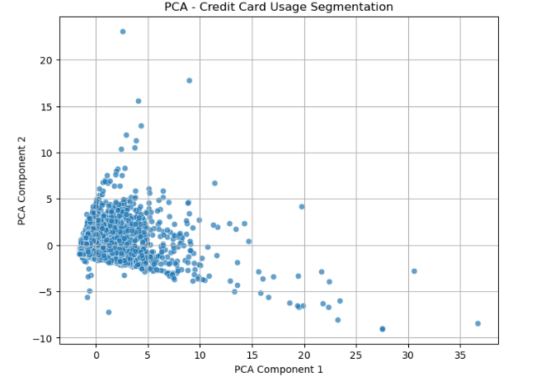
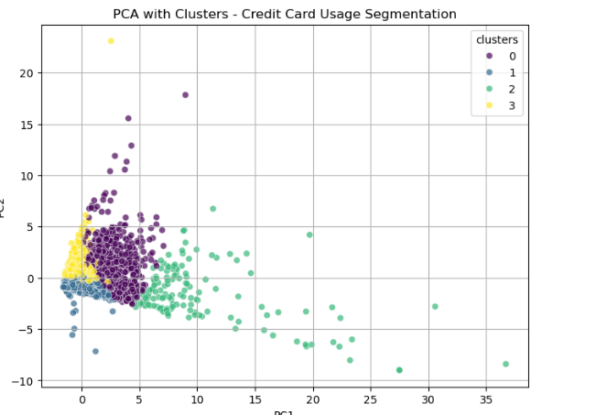
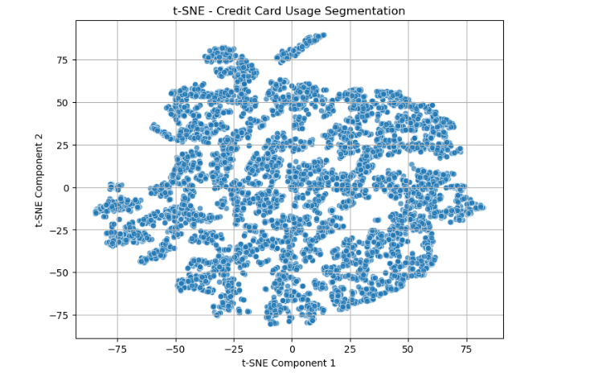
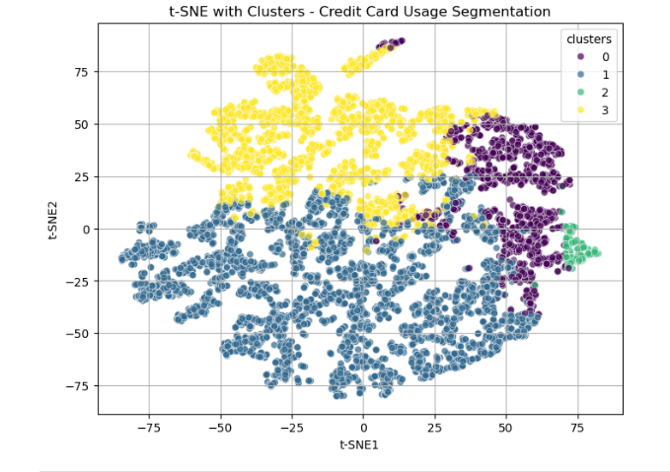

Slide 11
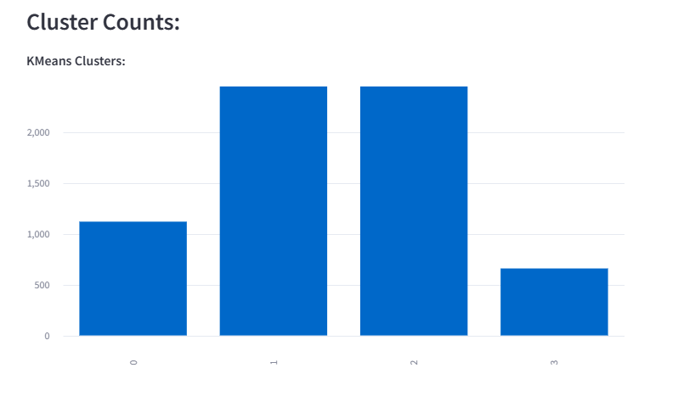
K-means cluster count:
0 - 1119
1 - 3466
2 - 3706
3 - 659

Slide 12
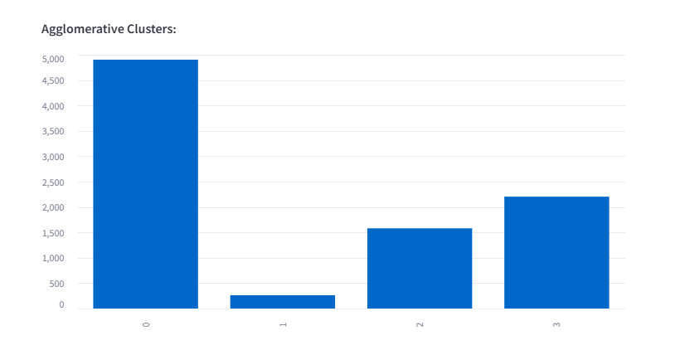
Agglomerative Cluster count:
0 – 4903
1 – 263
2 - 1580
3- 2204

Slide 13
Insights From Segmentation
What Did We Learn?
High Spenders (💳) Targets:
Premium offers, loyalty programs.
Encourage larger transactions.
Example: Offer exclusive deals on high-end products.
Minimal Users (🛍) Targets:
Convenience-focused perks.
Upsell small purchases.
Example: Cashback or discounts on low-spend items.
Cash Advance Seekers (⛔) Risky group:
Set strict credit limits.
Focus on education + EMI offers.
Example: Budget tips + EMI discounts for repayment.
Middle Users (📈) Targets:
Personalized offers to boost spending.
Loyalty rewards for steady engagement.
Example: Free delivery or small upsells.

Slide 14
Business Benefits
Why Does This Matter for Business?
🎯 Personalized Marketing = Higher Returns!
Target Big Spenders with premium perks (Example: Free airport lounge access 🛫).
Engage Essentials Users with deals (Example: Cashback on grocery shopping 🛒).
⛔ Risk Minimization = Control Over Bad Debts
Monitor Credit-Reliant Borrowers (Example: Customers often taking cash advances 💵).
Offer EMI discounts 💡 to reduce financial stress.
💳 Improved Satisfaction = Retention!
Build loyalty for Big Spenders with rewards (Example: Premium memberships 🌟
.
Retain Essentials Users with cashback offers 💰 (Example: 5% cashback on small purchases).
🚀 Long-Term Growth = Strategic Wins!
Convert Minimal Users into regular spenders 🔄 (Example: Discounts on every 5th purchase).
Boost engagement for consistent profits 📈. Flowchart:

Slide 15
Flowchart:
📊 Segmentation (4 Clusters) ↓ 🎯 Offers & Risk Control ↓ 🤝 Happy Customers ↓ 🚀 Higher Profits + Lower Risks

Slide 16
Slide 11: Conclusion
What Did We Learn?
📊 Credit Card Segmentation Helps To:
🎯 Know Customers Better: Understand spending habits for each cluster.
💡 Create Targeted Offers: Personalized perks for Big Spenders, Essentials, etc.
⛔ Reduce Risks: Manage Credit-Reliant Borrowers proactively.
🤝 Boost Retention: Keep customers loyal with tailored rewards.
Future Scope
🔍 Explore deeper customer segments (e.g., age, location, spending behavior).
📈 Predictive models for better decision-making and growth.

Slide 17


